Slide 1


AI Agents in the Data Pipeline
Craig West
https://craig-west.netlify.app/
https://evaluating-ai-agents.com/
Talk Slides and Repo:
https://github.com/Python-Test-Engineer/earl2025
This also contains links to a video of the BrighonPy talk/workshop on
‘AI as API’ and the repo for the PyData Southampton Meetup ‘AI Agents in
The Data Pipeline’ as well as additional resources.

Slide 2
Desired Outcomes
To better understand the Agent Landscape, its terminology, basis and uses.
To see the uses of AI Agents in the Data Pipeline and the likely future of Data Pipeline applications.
This is a ‘fly by’ rather than ‘deep dive’. The repo has more detailed examples and links to help you go further and deeper.

Slide 3


Raw code implementation of an Agent
No more difficult than what we do currently – just 180 degrees different
“It doesn’t get any easier – just different” - Anon

Slide 4
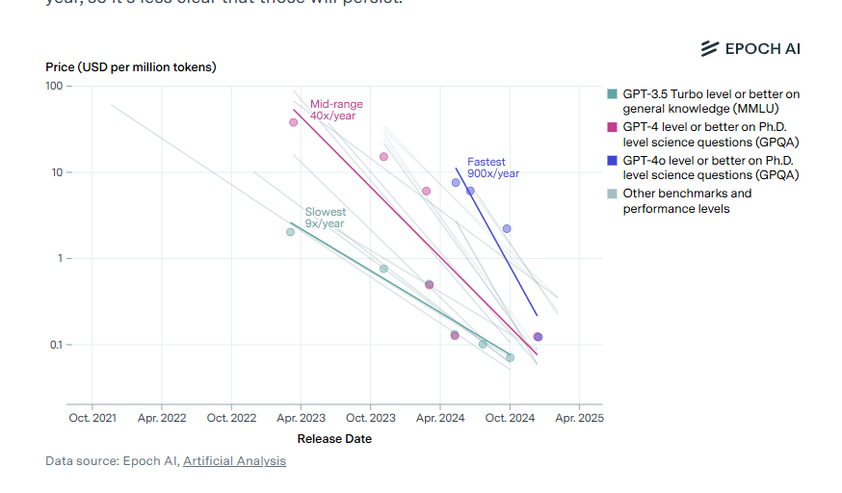
Model costs

Slide 5
Agenda (1)
With code examples where appropriate:
AI Agents from scratch
Tool/Function calling
Agentic Patterns
Demos

Slide 6
Agenda (2)
With code examples where appropriate:
Image Analysis
Agents that write code to carry out ETL, Data Analysis
MCP – Model Context Protocol
A2A – Agent to Agent protocol
Full demo using Cline in VSCode to create full app

Slide 7
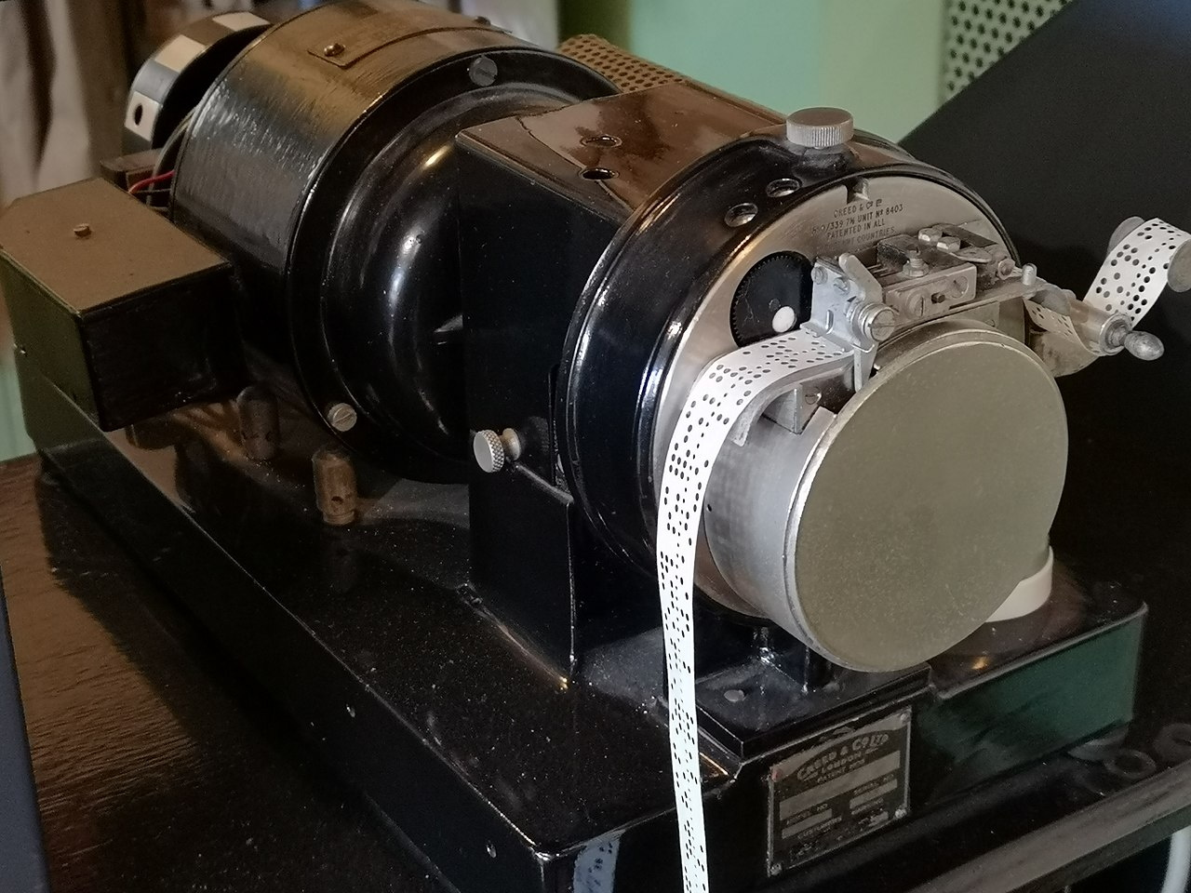
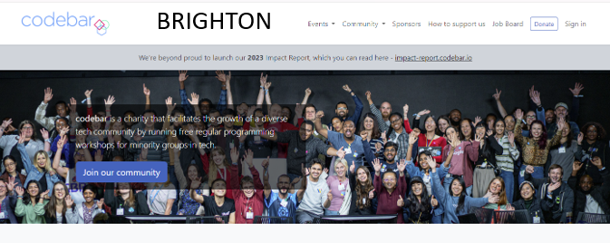


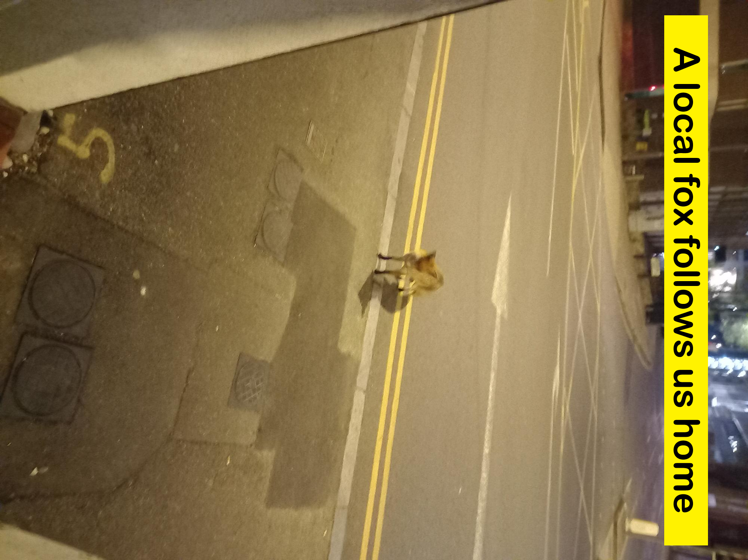
About me
I live about 1 mile north…

Slide 8
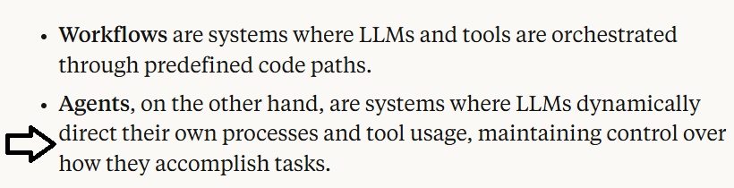
What is an AI Agent?
Many definitions but people opt for ‘Agentic Apps’
Anthropic

Slide 9
Using email as an aid
Let’s use the example of an email. We use HTTP POST to send the message to a SINGLE endpoint
Payload of instructions and context (info) that we send for the end user to process for us and return a response.
An LLM call in an Agent is similar…

Slide 10
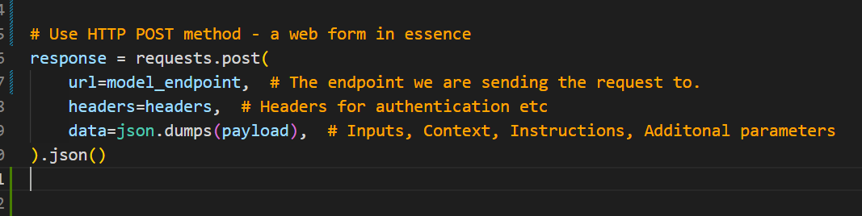
Raw code implementation of an Agent
Let’s look at 01_raw_post_request.py in the repo…

Slide 11
Prompts and Context
“Tell me about Data Analytics in 100 words…” will give a pretrained response…
“ Tell me about Data Analytics and how it can help me with our sales analysis for the last quarter…” will give us a response of: “I need more info…” as it has not been trained on our data.”

Slide 12
Supplying more Context (info)
“Tell me about Data Analytics and here is some data from our company, please analyse…”
This is context engineering where we supply appropriate context for the Agent.
RAG is Retrieval Augmented Generation and is RETRIEVING extra content from a range of sources for the prompt – not just Vector Databases.

Slide 13
What is Tool/Function calling?
Tool/Function Calling – adding more context/info
“Tell me about Data Analytics and here is some data…
Also compare our share price with {company X}…”
We don’t know this information at time of request as it will vary with each query.
We need a tool/function the Agent can use to get the share price… “tool/function calling”

Slide 14
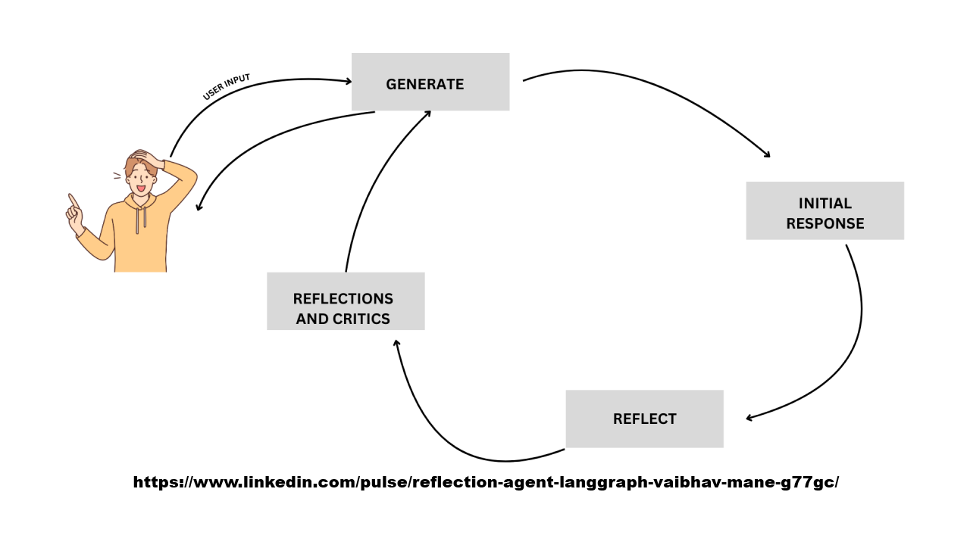
What is Tool/Function calling?
In our INSTRUCTIONS we can add:
Here are some useful tools/functions that may be of help at run time.
Let me know which you want to run and with what arguments.
I will run them on my machine and then send this extra CONTEXT back to you (reflection – see image)
03.1_prompt.md has the prompt
03.2_demo_tool_calling.py

Slide 15
Reflection Pattern - looping

Slide 16
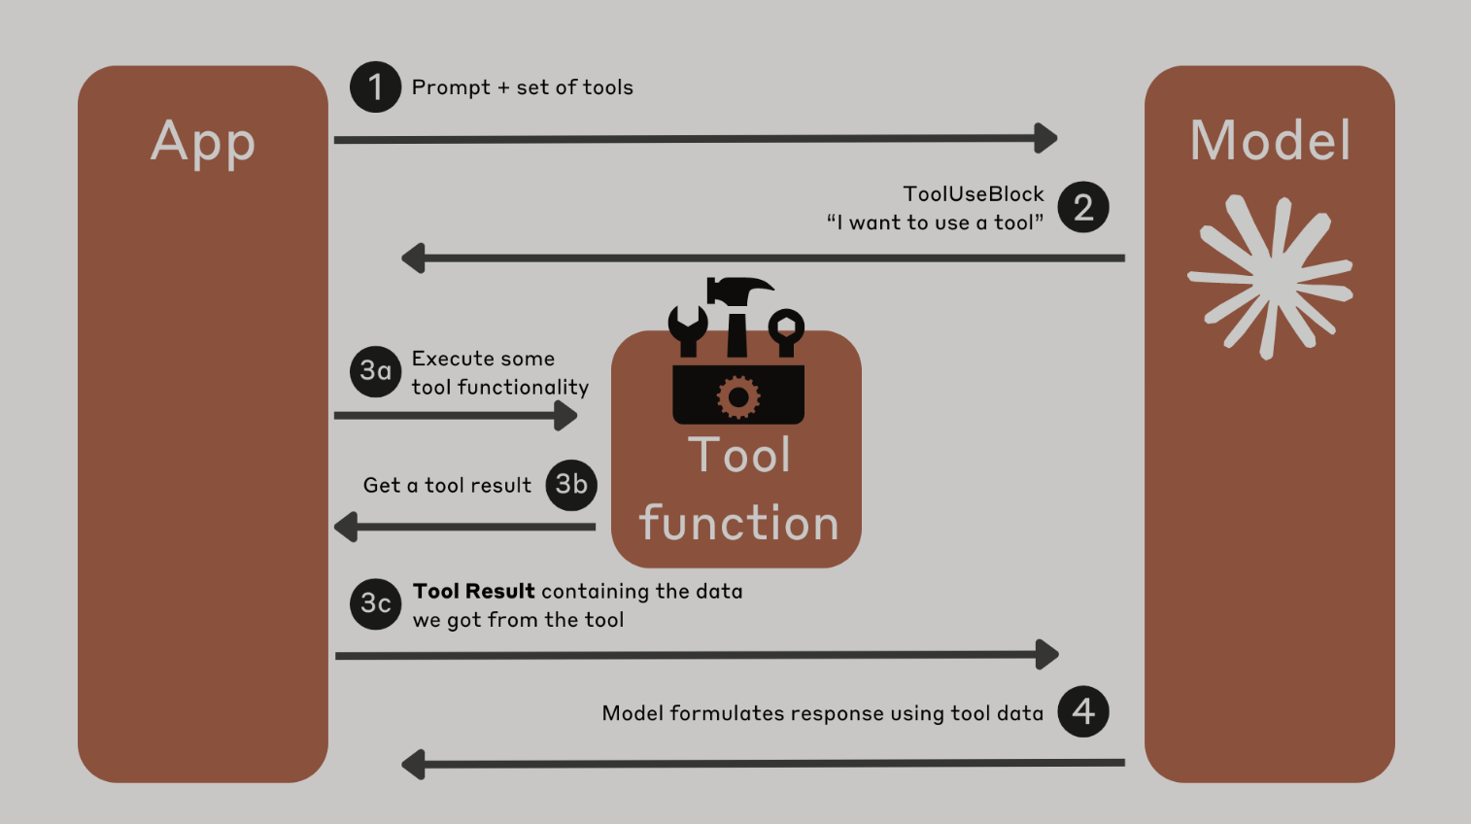
What is Tool/Function calling?

Slide 17
Another example of reflection
We ask Agent to write some code for us, then another to critique it and then a final one to combine the two.
“Generate a Python implementation of imputing missing values in a Pandas DataFrame with the mean of the column.
Ensure there are plenty of comments explaining the code.”
04_demo_reflection.ipynb -> three files:
04.1_code.md
04.2_critique.md
04.3_final.md

Slide 18
What is the Model Context Protocol (MCP)?
We have seen how we can write tools for the Agent to discover and call as needed.
What about tools others have created?
How can an Agent discover what tools are available, how to use them with what ever arguments are needed and how to execute them?
This is Model Context Protocol.
In essence, an Agent can find a list of tools we have given it, with these tools able to inform Agent how to use them.
The Agent runs the pipx to download and run them in a separate process.

Slide 19
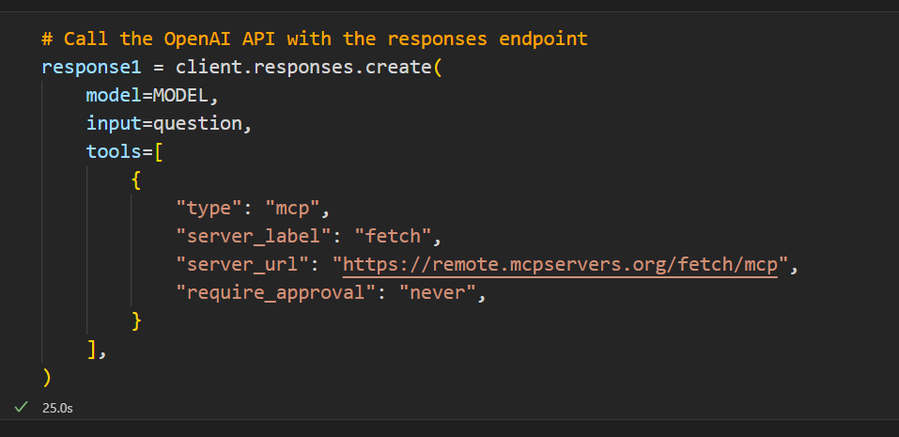
What is the Model Context Protocol (MCP)?
https://mcpservers.org/servers/modelcontextprotocol/fetch

Slide 20
What is the Agent2Agent Protocol (A2A)?
A complimentary protocol to allow one Agent to discover and understand what another Agent does.
It can then hand off work to the other Agent to get a desired response.
It might seem that tools, MCP, A2A are all similar!
At the end of the day Python is variables and code…all objects and essentially variations on functions.
Protocols, like HTTP for example, are implementations to enable communication between bits of code.
Next…an example from Google…

Slide 21
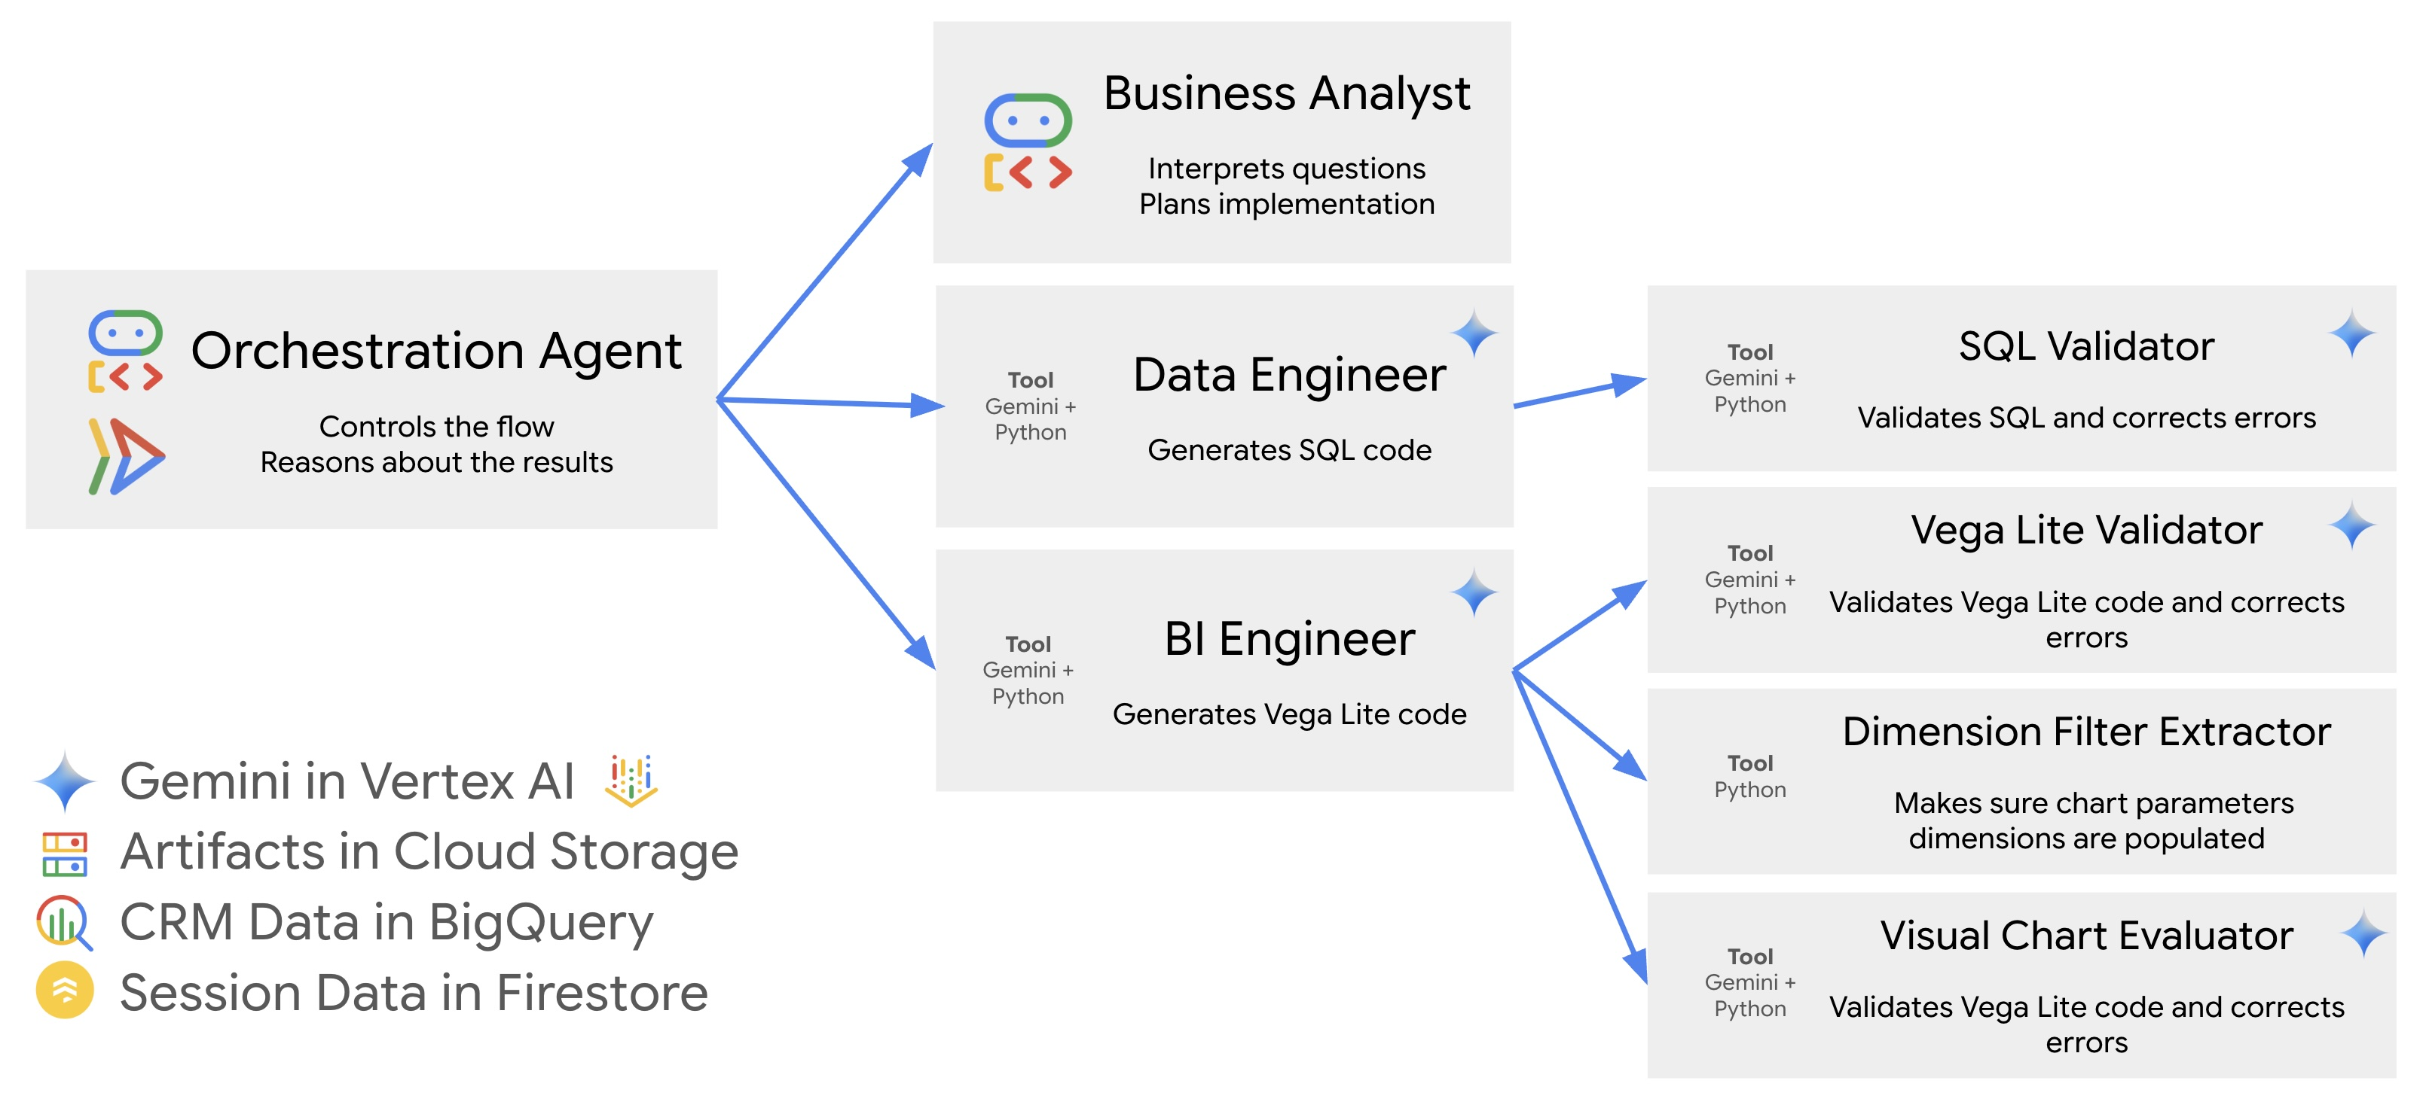
Google CRM Agent (1)

Slide 22
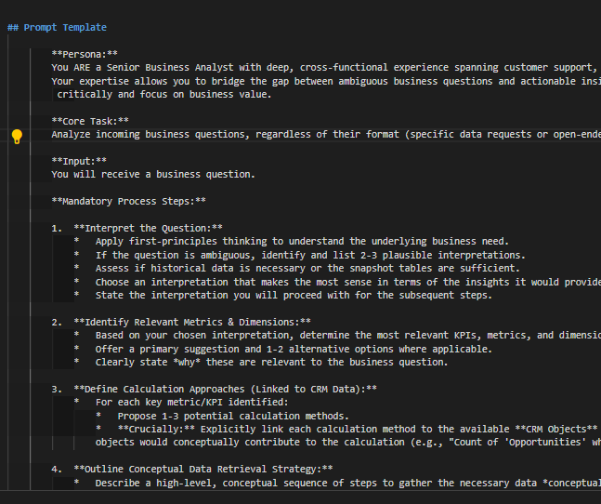
Google CRM Agent (2)
https://github.com/vladkol/crm-data-agent/blob/main/src/agents/data_agent/prompts/crm_business_analyst.py
06_demo_prompt_google_crm.md
We can learn a lot about best
practices for Context Engineering by
looking at big tech repos.

Slide 23
A complete demo (1)
Using Cline to create a complete pipeline…in practice devs do it bit by bit.
Let’s look at an example…

Slide 24
A complete demo (2)
CLAUDE:
create a simple sales csv with just 5 rows
sales_data = [
['Date', 'Product', 'Quantity', 'Unit_Price', 'Total'],
['2024-01-15', 'Laptop', 2, 999.99, 1999.98],
['2024-01-16', 'Mouse', 5, 29.99, 149.95],
['2024-01-17', 'Keyboard', 3, 79.99, 239.97],
['2024-01-18', 'Monitor', 1, 299.99, 299.99],
['2024-01-19', 'Headphones', 4, 149.99, 599.96]
]
CLINE:
“I have a CSV for some sales data. Make a simple ETL and data analysis programme for it to show plots and graphs.”
IN DEMO: I will add…
[“There is already a folder called `sales_etl_analysis` - please ignore and start afresh”]

Slide 25
Summary
It has been 3 years since ChatGPT was released.
The 6 months from arranging this talk to doing it is a very long time in AI with great changes in that time.
The next 6 months/1 year/2 years?
Craig West
https://craig-west.netlify.app/
https://evaluating-ai-agents.com/
https://github.com/Python-Test-Engineer/earl2025

